Slide 1
Membership Committee
Kara Bixby
Diana Perez Cordova
Danelle Marable
Chantal Hoff
Trish Dao-Tran
Programming Committee
Hila Bernstein
Sharon Tuow
Dana Benjamin-Allen
Kelly Washburn
Governance
Eileen Marra
Elizabeth Brown
Matan BenYishay
Min Ma
DEI Committee
Fatima Fairfax
Ben Faust
Christine Patton
Sarah Faude
Alemayehu Bekele
Anthony Black
Erin Shaw
Luba Falk Feigenberg
Tiana Yom
Noe Medina
Susan Putnins
Communications
Bryan Hall
GBEN runs on the shoulders of its volunteers.
Thank you for all you do!

Slide 2
2021
YEAR IN REVIEW
Notes:
Question: What’s the best format when we return to in person?
Process:
Pilot with existing members
Blurb in newsletter / event sign-up on website
Targeted e-mails → pull new member list
Future: Pair with a roundtable (orientation / meet fellow new members → then go right into a session together)
Feedback on people’s comfort level about going back in person
New Member Page → resource repository, direct new members there
Facilitator’s notes:
During welcoming, instruct attendees to add to name/org, etc… to chatbox

Slide 3
Plan for today
9:00 Gathering & Welcome from the President
9:15 Chat with each other (breakout rooms)
9:30 GBEN’s strategic vision (3 breakout groups by topic area)
9:50 Closing

Slide 4
GBEN’s mission
Our mission is to promote excellence, innovation and equity in evaluation among professional and aspiring evaluators, and those who align their work with the discipline of evaluation in Greater Boston. We do this through professional development, resource-sharing, and networking around evaluation approaches and best practices.

Slide 5
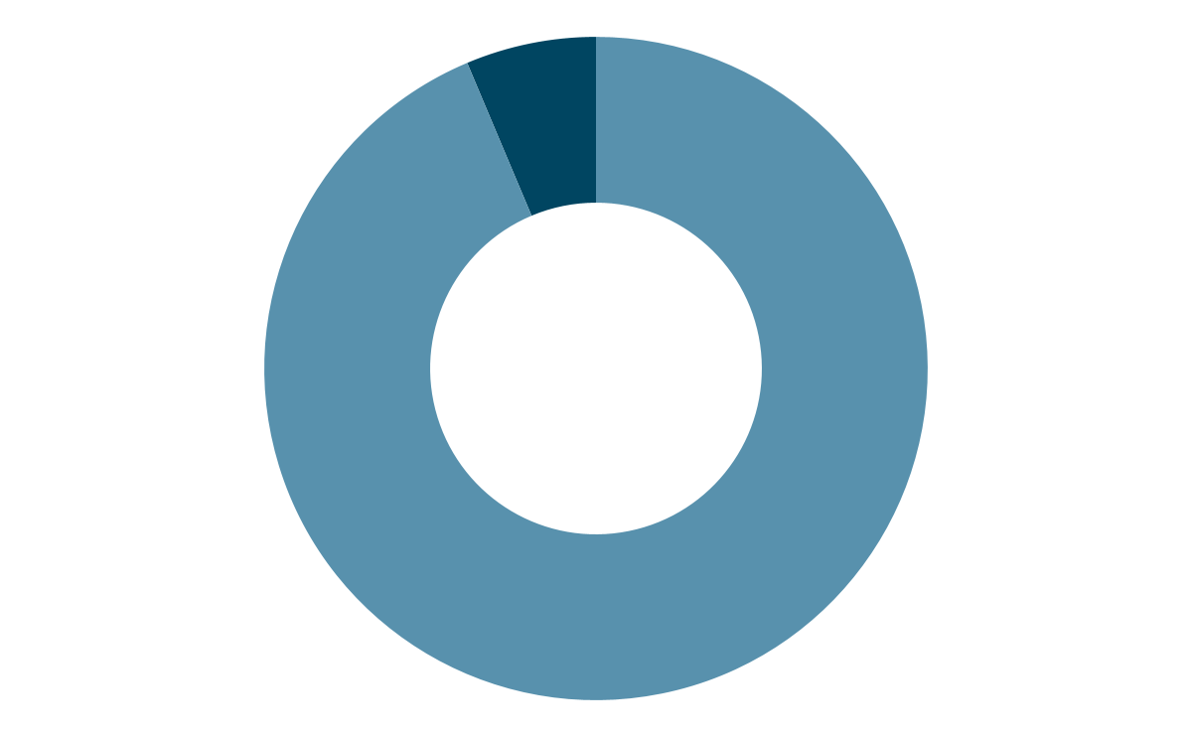
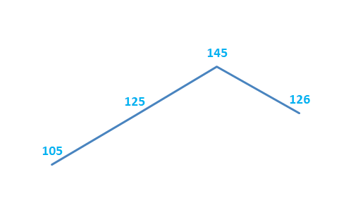
Our Members
Members since 2018, our first year of paid membership
126 members
118 Professional Members
8 Student Members
2018 2019 2020 2021
Notes:
Question: What’s the best format when we return to in person?
Goals
Orient new members to GBEN
Relationships
Asking how to get involved
Leadership pipeline → helping ppl think about how to get involved / get
“Cohort” experienced (I joined with someone)

Slide 6
Our Programs & Partners
8 Virtual Roundtables and Workshops in 2021
Topics
Reflections on "Value" with E-valuation: A Book Talk by Authors Thomas Schwandt and Emily Gates
Ready to Engage?: Development a Learning + Action Agenda to Conduct Culturally Responsive and Racial Equity Evaluation
Inside Job: Strategies for maximizing the impact of your internal evaluation practice
Data Corners
Data Viz Show & Tell
Culturally Responsive Evaluation (CRE) Theory to Practice
Critical Race Theory, Part 1
Bring an Idea, Leave with New Perspective(s)
62% of members attended at least 1 event
GBEN Partners
NU-PEL
AaEA
Boston College
AEA Internal Evaluation TIG

Slide 7
Diversity, Equity & Inclusion
Committee development
Completed three-year strategic plan & report to support ongoing DEI visioning and planning by GBEN
Selected new co-chairs for the DEI Committee
Developed new DEI Committee structure & operating plans
Support across the organization
Supported Critical Race Theory roundtable
Contributed to GBEN member demographic survey
Learning with our peers
Collaborated with BC in launching SCENE Collaborative for New England evaluators
Shared and learned with other local AEA affiliates
Notes:
Completed three-year strategic plan & report to support ongoing DEI visioning and planning by GBEN
Supported Programming Committee on Critical Race Theory roundtable
Collaborated with BC in development and implementation of SCENE Collaborative
Contributed to GBEN member demographic survey developed by Membership Committee
Shared and learned with other local AEA affiliates through LAC calls, presentations, and informal discussions
Selected new co-chairs for the DEI Committee
Developed new DEI Committee structure & operating plans

Slide 8
Communications
greaterbostoneval@gmail.com
10 monthly newsletters
Delivered nearly 1,500 times
Opened by 60% of members
Maintained LinkedIn group
Launched Twitter account
http://greaterbostoneval.org
@EvalBoston
linkedin.com/groups/8177131/

Slide 9
Membership
Recruited and onboarded two co-Chairs & one new member
Developed and held a New Member Orientation to create a warm welcome for and connect GBEN members with each other.
Nurturing the SCENE Collaborative in partnership with Boston College Lynch School of Education
Engaging with the art, heart, and complexity of collecting & intentionally using membership demographic data
Intentionally building the Committee & Leadership’s capability to co-create offerings based on community feedback: What does community & engagement look like, feel like, for whom?

Slide 10
Leadership Transitions!!
GBEN gives thanks to founding and outgoing President Danelle Marable...
…and welcomes new committee co-Chairs to the board!
Dana Benjamin-Allen, Programming Committee
Chantal Hoff, Membership and Outreach Committee
Trish Dao-Tran, Membership and Outreach Committee
Susan Putnins, DEI Committee co-chair
Noe Medina, DEI Committee co-Chair

Slide 11
President’s Vision
Notes:
GBEN as adopted professional home for past few years
In committee roles since day 1 - have enjoyed thought partnership, camaraderie, & generous sharing of skills/opps among members
Vision is that GBEN continues to foster meaningful connections among those in our region who do evaluative work
& for GBEN to be an even more diverse, dynamic org in which members actively share in leadership & feel ownership over the mission
You’ll hear more about our strategic plan during breakouts - roadmap to get there requires internal work to dev shared principles, strategic intentions – & external work with partnerships/community building

Slide 12
Break out #1
What do you want to receive from GBEN this year?
What do you want to offer
to GBEN this year? (join a committee; ideas for what we do, how we do things; eval expertise to share?)

Slide 13
Break out #2
3 Groups:
Programming
Community-building
Diversity and inclusion of GBEN members
What are we working on?
Reactions?
Ideas?
Notes:
Programming (DEI+ Programming)
Community-building (Programming +Membership)
Diversity and inclusion of GBEN members (DEI + Membership)

Slide 14
Here’s how to get involved and/or share an ask
Email us at: greaterbostoneval@gmail.com or contact committee chairs directly
Governance: Min Ma & Matan BenYishay DEI Committee: Susan Putnins & Noe Medina Membership: Trish Dao-Tran & Chantal Hoff Programming: Dana Benjamin-Allen & Kelly Washburn Communications: Bryan Hall

Slide 15
Thank You!!
greaterbostoneval@gmail.com
http://greaterbostoneval.org
@EvalBoston
linkedin.com/groups/8177131/

